Slide 1


2 Data Acquisition and Processing
Guido Borghi, PhD
guido.borghi@unibo.it

Slide 2
2.1 Data Acquisition
Datasets
Data Acquisition
Data Annotation

Slide 3
Machine Learning pipeline
In these slides we focus particularly on the first steps, namely the acquisition and processing of data required for the creation of our system based on Machine Learning.
Still today, this is one of the most important steps for many companies:
«Data is the new oil of the Digital Economy»
Indeed, there are several disciplines focusing on data (Data Science, Data Mining, Big data, …)
However, acquiring data is a time-consuming, investment and knowledge-intensive process
In Italy (but now in many areas of the world), there can be problems related to privacy
When is it “right” to protect privacy? When does it become a limit?
DATA ACQUISITION
DATA PROCESSING
MODEL
PREDICTION

Slide 4
Data Acquisition
Data acquisition is the first step in developing an ML system
We can get data mainly in two ways:
By using publicly available data (datasets or databases) → someone collected them for us!
They can be free or for a fee
The quality of the data made available must be checked
By acquiring a new set of data, but why?
It is not certain that public data well represent the problem we want to solve
We want to acquire specific data and thus generate specific expertise for the company (know-how)
We are forced to acquire data that due to their sensitive nature would not otherwise be available (privacy issues)
The company we work for already has a data collection process that we can use

Slide 5
Public Datasets
Many universities publicly release their datasets:
There are no requirements related to profit or non-disclosure agreement (NDA)
It is a consolidated practice in the world of research
It is the basis of the scientific method, in particular for the reproducibility of the results obtained
I release my data so that others can conduct my own experiments, verifying my results and perhaps proposing better solutions!
Examples:
https://aimagelab.ing.unimore.it/imagelab/datasets.asp
https://vlomonaco.github.io/core50/
https://www.image-net.org/
Other platforms make datasets available for competitions:
Kaggle: https://www.kaggle.com/datasets
https://medium.datadriveninvestor.com/kaggle-data-science-platform-alternatives-for-competitions-and-research-cbe051596e62

Slide 6

Acquisition of a new dataset
Acquiring a new dataset is usually a costly process!
Investment of time and money for:
Programming or learning to use an acquisition tool
Handling of large amounts of data
Testing to find any bugs that could compromise the success of the acquisition (and we often notice them at the end of the process)
Acquire new hardware for data collection and storage
→ It is necessary to carefully consider whether it is appropriate to acquire a new dataset.
Considerations not only in engineering, but also in management and economics.
Future needs must be foreseen in advance.
NB: acquiring a new dataset does not mean acquiring only new data!!

Slide 7
Data Annotation
Indeed, one of the most relevant aspects is the annotation of the data
The specific annotation is usually called “label” and is the (semantic) content of the data.
The label depends on the problem we want to solve and can be numerical or categorical
Examples:
A person's height prediction → data: joint lengths, label: height (cm)
Pedestrian Detection → data: images, label: presence of a pedestrian (yes/no)
Pedestrian Localization → data: images, label: position of the pedestrain (x, y, w, h)
Audio classification numbers → data: audio sequences, label: number («five»)
A single data is therefore defined as annotated if it is associated with a label
Data collected without correct and timely annotation is often useless
However, it is also possible to “extract knowledge” from un-annotated data through, for instance, clustering

Slide 8
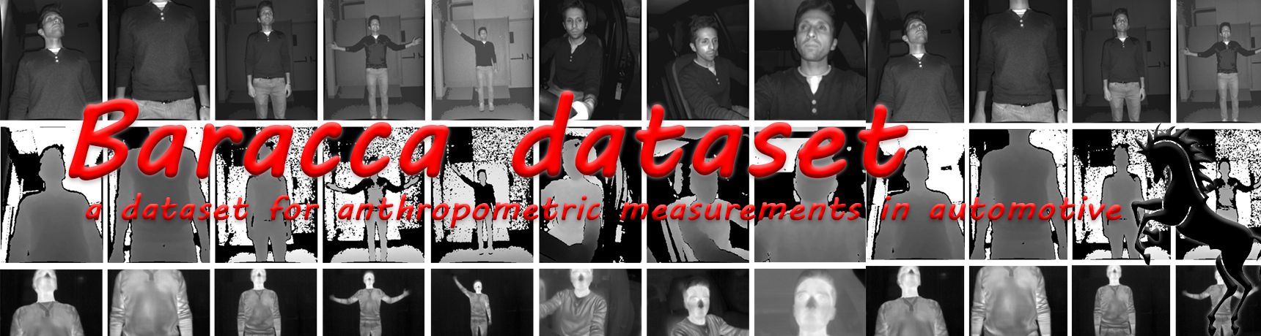
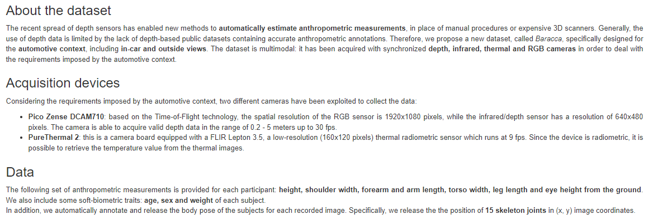
Example of Data Annotation
Data
Labels
https://aimagelab.ing.unimore.it/imagelab/page.asp?IdPage=37

Slide 9
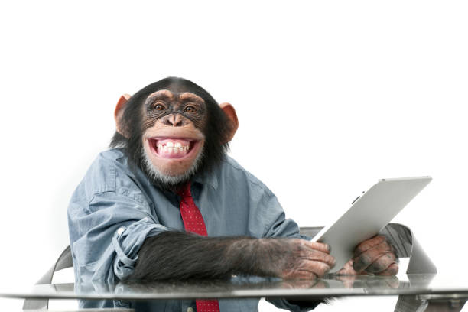
Data Annotation process
The data annotation process can take place in several ways:
Manual: each data is manually annotated
Long and expensive process
The quality of the annotations is usually controllable and high
This is not always an applicable process (for example, is it possible to annotate a dataset with 1M of images?)
Automatic: each data is automatically annotated, using specific tools
It is based on particular a priori knowledge (for example, all images acquired in a dog shelter depict dogs).
The quality of the annotations is not always easily controlled
Third parties: all data is noted by a third party
Free of charge: this is the case, for example, in which users barter the free use of some platform with the transfer of their annotated data (for example, photos uploaded to Facebook accompanied by information regarding the content, the position of the face, or scene acquired).
Paid: there are platforms where is possible to purchase annotation time from third parties (often from “developing countries”). Example: Amazon Mechanical Turk

Slide 10
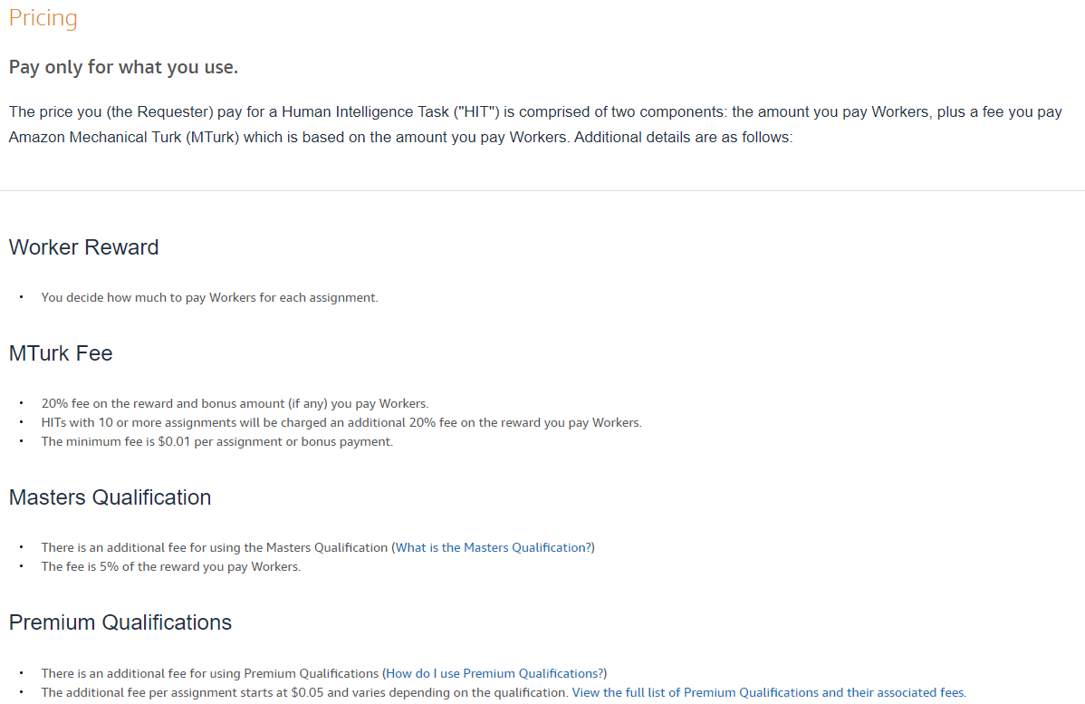
Amazon Mechanical Turk
Quality?
https://www.mturk.com/

Slide 11
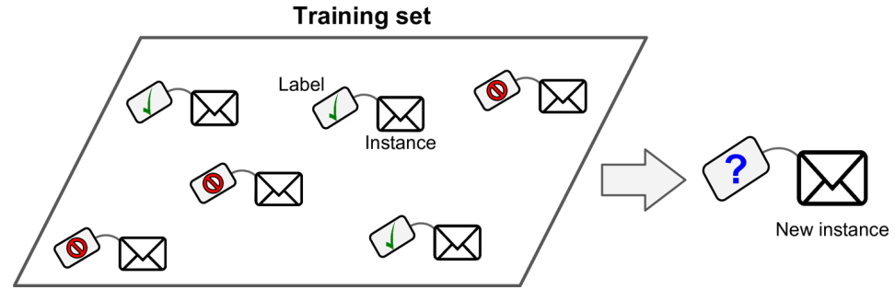
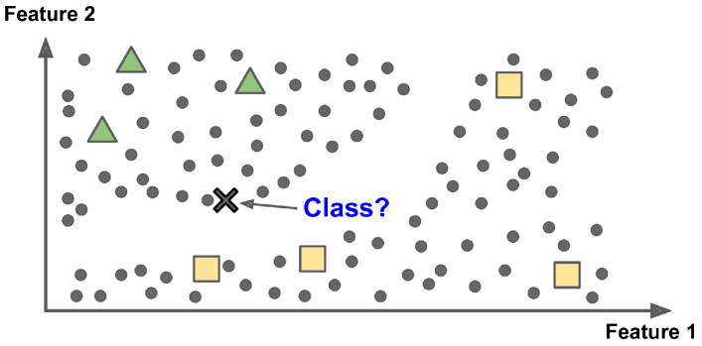
Different ways of Learning
We define different types of learning depending on data annotation:
Annotated data → Supervised Learning
One of the most studied types that allows to obtain the best results
Not annotated data → Unsupervised Learning
The results that can be obtained are usually worse than the previous case
Partially annotated data → Semi-Supervised Learning
Specific algorithms correspond to each of these areas
The best performances are usually obtained with supervised trained algorithms.
→ In this course, we will work on fully annotated data → Supervised Learning

Slide 12
Open and Closed set
Last aspect to be defined relating to data annotation: do we know all annotations?
Closed Set: it is assumed that the pattern to be classified belongs to one of the known classes.
The most common case in machine learning benchmarks
Ideal condition, but not always suitable for real-world systems
Open Set: the patterns to be classified can belong to none of known classes.
More realistic condition, but more challenging
Example: classify all fruits into {pears, bananas}
Two possible solutions to the open set problem:
An additional fictitious class is added to the classes (“the rest of the world”, “unknown”) and the so-called “negative examples” are added to the training set.
You allow the system not to assign the pattern. To this end, a threshold is defined and the pattern is assigned to the most likely class only when the probability is higher than the threshold.

Slide 13
Common problems in Data Acquisition
Companies usually face common problems:
The business process produces huge amounts of data
It is almost impossible to acquire all the data
Also, physical limitations when the data stream is bigger that the storing capacity
Usually, it is necessary to choose which ones to store
Sometimes companies have a lot of “old” data in their databases or information systems:
They don't know what to do with it
Data re-collection on existing data (since data must be clean or something similar)
In many business processes it is unclear understanding:
Which data is possible to collect (also due to privacy issues)
Which data is (really) useful for the business

Slide 14
2.2 Data types
Numerical, Categorical, Sequences and Structured Images and Audios

Slide 15
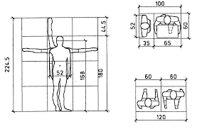
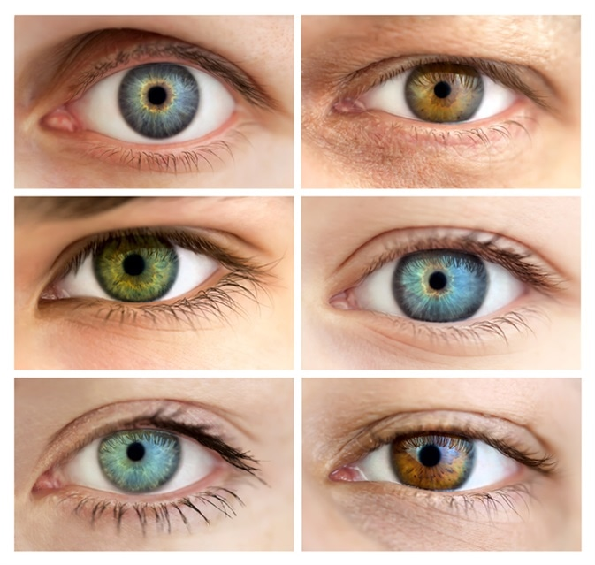
Data types
In general, there are 4 types of data:
Numerical:
Values ​​associated with measurable characteristics or counts
Typically, continuous (but also discrete), in any case subject to ordering
Examples related to the person: height, hip circumference, foot length, …
Other examples: images (measures of the light level)
Categorical:
Values ​​associated with qualitative characteristics and the presence/absence of a characteristic (yes/no value)
Sometimes subject to sorting (for example, high, medium, or low ambient temperature)
Examples related to the person: gender, eye color, blood group, …

Slide 16
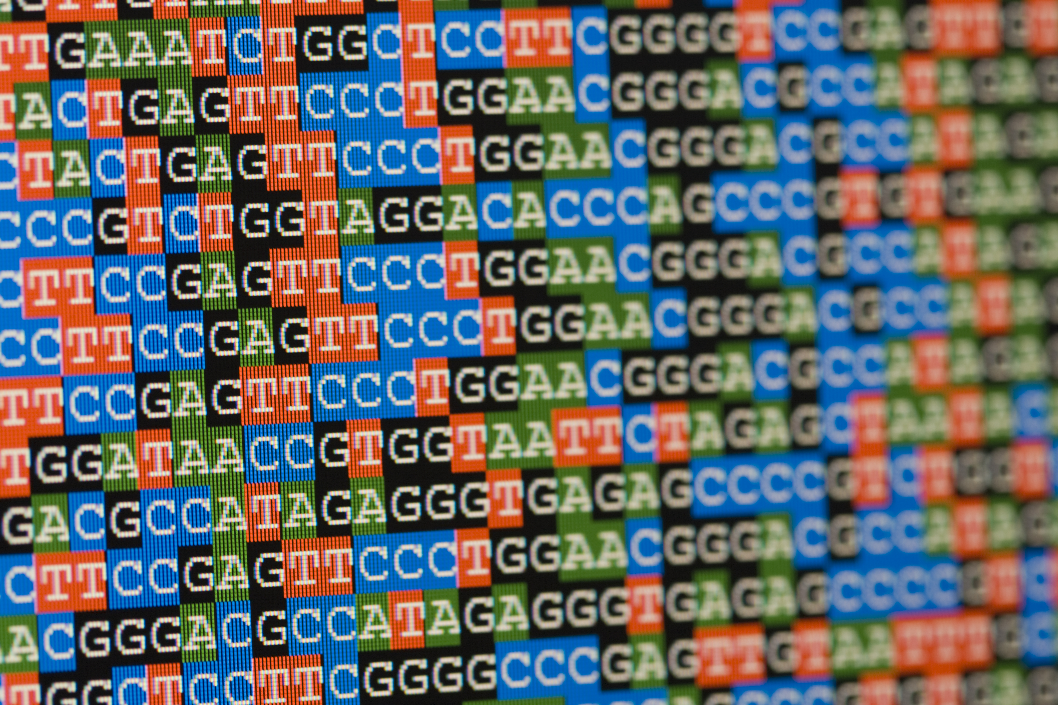
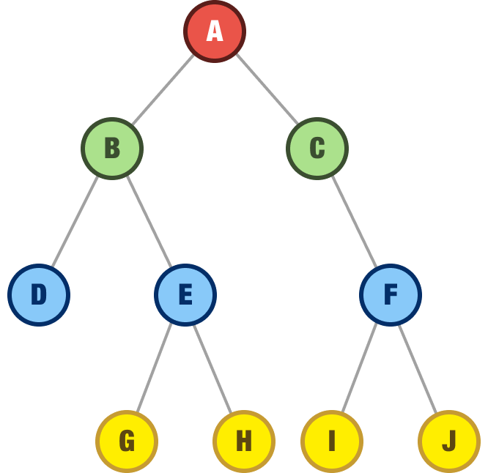
Data types
Sequences:
Sequential patterns with spatial or temporal relationships
Often with a variable length
Key element: memory (for the past), spatial/temporal alignment
Examples:
An audio stream (sequence of sounds) corresponding to the pronunciation of a word
A sentence (sequence of words) in natural language
A video (sequence of frames, images)
The performance of a stock exchange (time sequence of the closing price)
Structured data:
Outputs organized in complex structures such as trees and graphs
Applications in Bioinformatics, Natural Language Processing, Speech Recognition, …

Slide 17
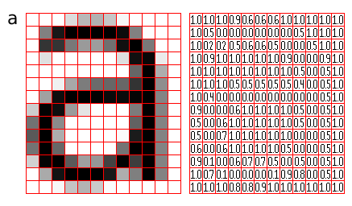
Images
How is possible representing images?
For a computer, an image is a matrix of values
Each cell is referred as pixel (PIcture ELement)
Each pixel contains the value of the brightness
The range of the pixel values varies from 0 (black) to 1 (white)
Usually, pixel values are represented with 1 byte (8 bit), then the range is from 0 to 2⁸ -1= 255
The spatial resolution is the width and the height of the matrix (MxN, that is related to the sampling density of the sensor). In this case is 12x14 = 168

Slide 18

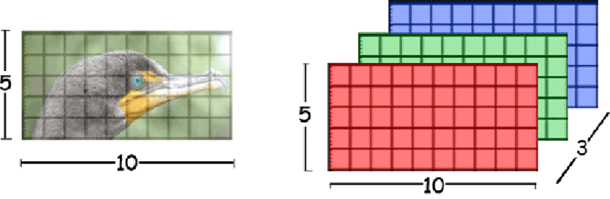
Color Images
In color images, each pixel contains 3 values that represent the color components
The color components are usually referred as channels
The content of channels are related to the color space, the convention used to define colors
For instance, the RGB color space:
3 values to indicate the value of the 3 components: Red, Green and Blue.
This three colors mixed together are able to produce others colors.
Many other color spaces are available: HSV, HSL, CIE Lab, CIE XYZ…
We use more than one value to code colors into images
https://en.wikipedia.org/wiki/Color_space

Slide 19
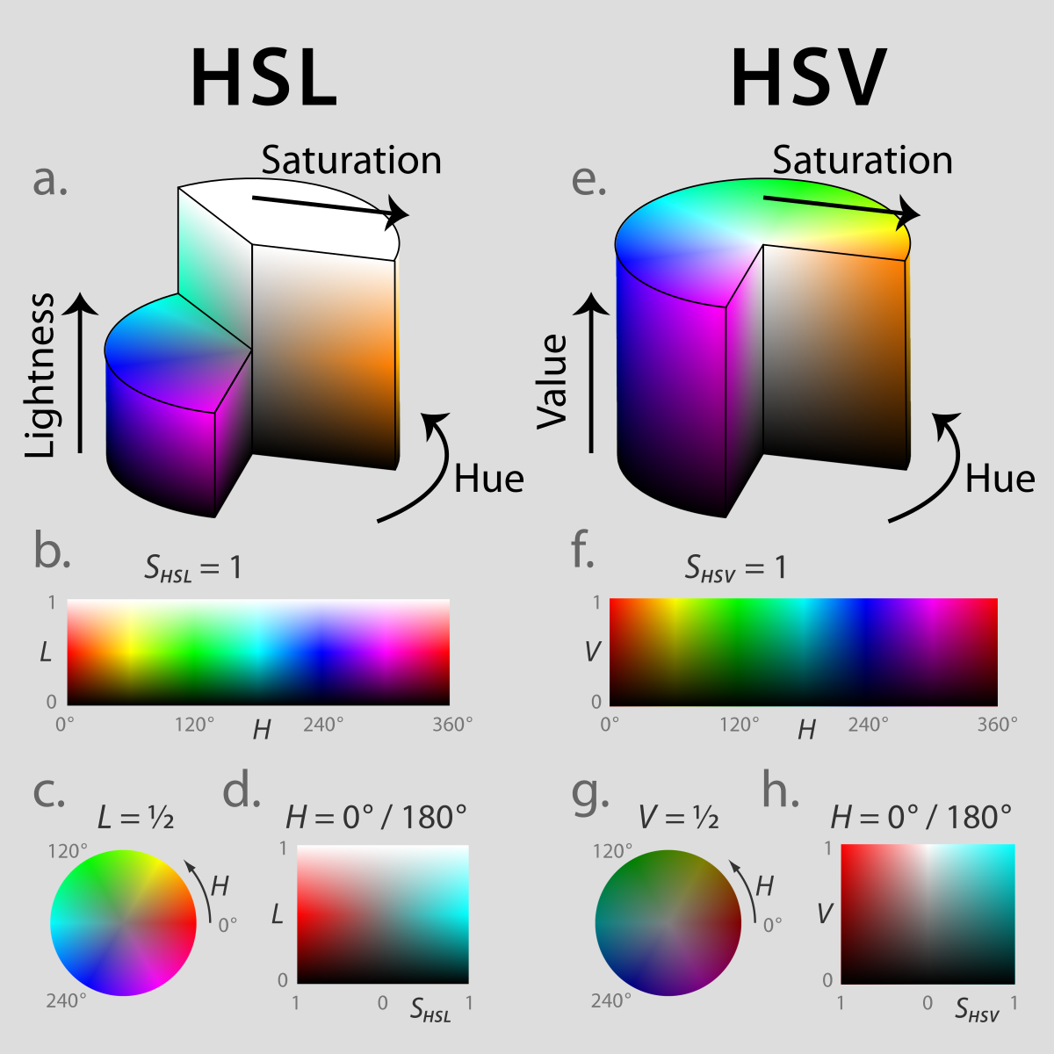
Color Spaces
With 3 different values into pixels, we can represent colors following different conventions, such as:
HSL (Hue, Saturation, Lightness)
HSV (Hue, Saturation, Value)
XYZ
…

Slide 20
Image formats
Image file formats are standardized means of organizing and storing digital images. For instance, an image file format may store data in an uncompressed format, a compressed format (which may be lossless or lossy), or a vector format and so on.
JPEG (Joint Photographic Experts Group): lossy format, used for digital images, especially for digital photography. The degree of compression can be adjusted. The ‘.jpeg’ filename extension is used to save the file.
GIF (Graphics Interchange Format): loseless format for storing graphical images up to 256 colors. PNG was created as a more powerful option to the GIF file format. The ‘.gif’ filename extension is used to save the file.
PNG (Portable Network Graphics): loseless format, which makes higher quality output. These files are commonly used to store graphics for web images. Supports transparency. The ‘.png’ filename extension is used to save the file.

Slide 21
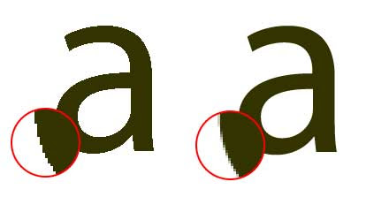
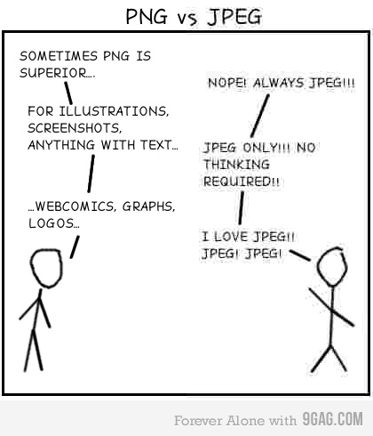

PNG vs JPEG

Slide 22
2.3 Data Preparation
Train, Val and Test
Types of Learning
Input data

Slide 23
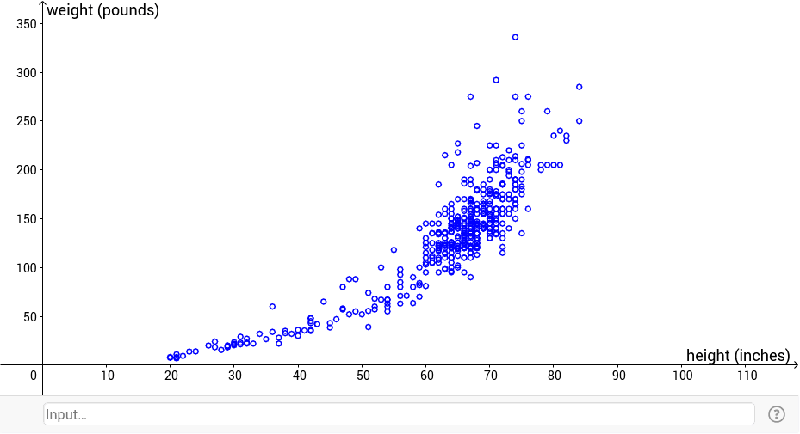
Definitions
Data: the elements contained in a set (dataset) that we are going to use in our algorithm
Each element can named as data point, observation, data sample, data.
Feature: individual characteristics or attributes used to describe and represent data points.
Also, the variables or properties that capture information about the data
The number of features is referred as dimensionality (!= the number of data)
If the dimensionality is 2, it is easy to plot and visualize the feature distribution
Examples:
In a dataset of housing prices, features could include the number of bedrooms, location, and number of bathrooms.
In a dataset of geometric shapes, features include the coordinates of the vertices of each shape
In a dataset of people, features could include only the height and the weight of each person.

Slide 24
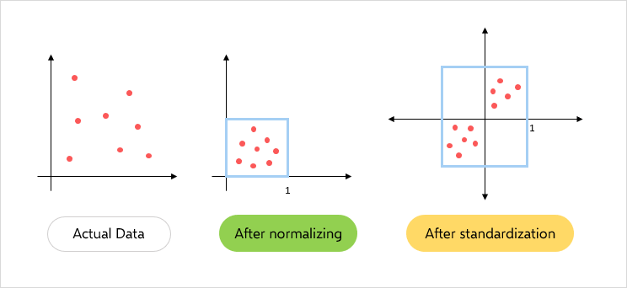
Data Preparation
Data Cleaning:
Most Machine Learning algorithms cannot work with missing features
Remember to replace missing values with a value (0, median value, average value, …)
You will see other techniques in the Data Mining module
Feature Scaling
Machine Learning algorithms don’t perform well when the input numerical features have very different scales
There are two common ways to get all features to have the same scale:
Normalization (also called min-max scaling)
Values are shifted and rescaled so that they end up ranging from 0 to 1
We do this by subtracting the min value and dividing by the max minus the min
Standardization
We subtract the mean value, and then we divide by the standard deviation
The resulting values will have zero mean and unit variance

Slide 25
Data Preparation
Once obtained (collected) data for our ML system, it is necessary to prepare them
You will always have to organize the data as follows:
Training set:
The data on which the model learns during the training phase
Usually, training phase is computational demanding (GPUs for training the NNs)
Validation set:
Usually, a part of the training set
On this data, the hyperparameters of the model are fine tuned
Testing set:
Data on which the model is tested and performance are collected
The testing phase tests the model effectiveness, also through qualitative and quantitative numerical measures
None element of the test set must be used in the train or validation!!

Slide 26
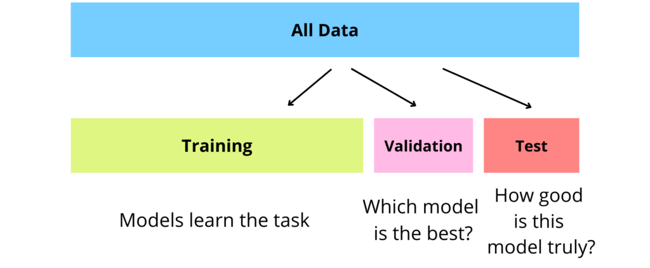
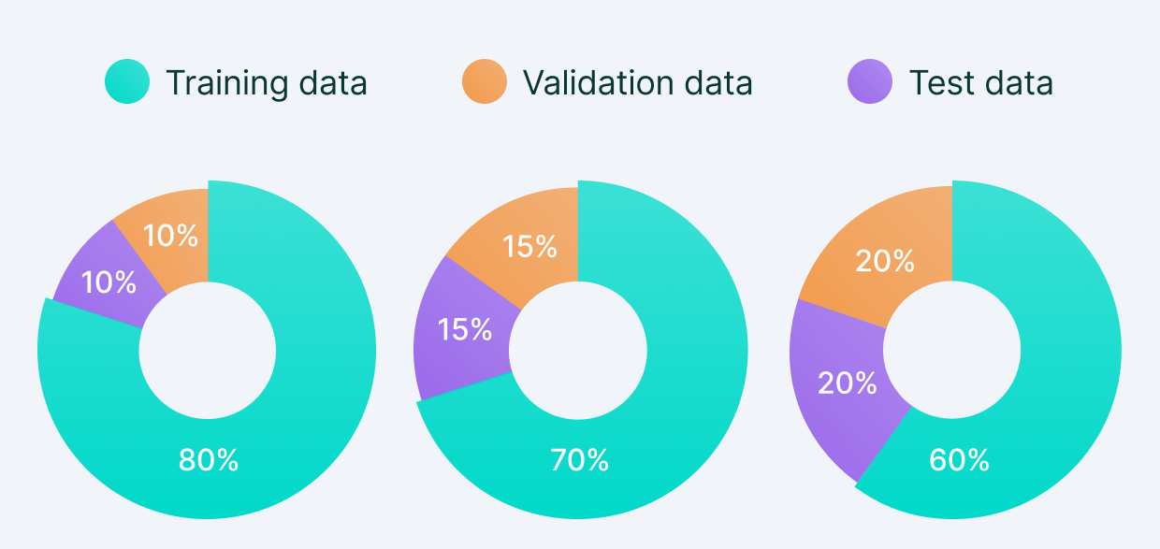
Data Preparation
NB: partitioning data in Training, Validation and Testing sets often requires to randomly generate the indices of the elements to assign to different sets!

Slide 27
Validation of the model
If the validation set is too small, then model evaluations will be imprecise.
K-fold cross-validation:
With few data, a more robust choice of hyperparameters is obtained with the k-fold cross-validation
How to implement k-fold:
Define parameter k → the train data are divided into k parts (of equal number)
For k times:
The model is trained on k-1 parts, the rest is used as a validation set
The accuracy is calculated as the average or median of the k tests
The hyperparameter configuration that offers the best mean or median is chosen
Once the optimal hyperparameters have been chosen, the model is re-trained on the entire training set and, only at this point, does the performance on the test set occur.

Slide 28
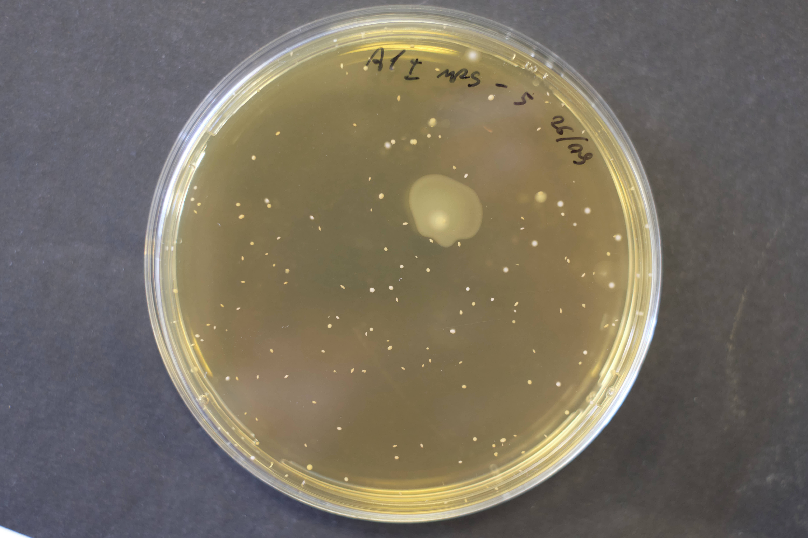
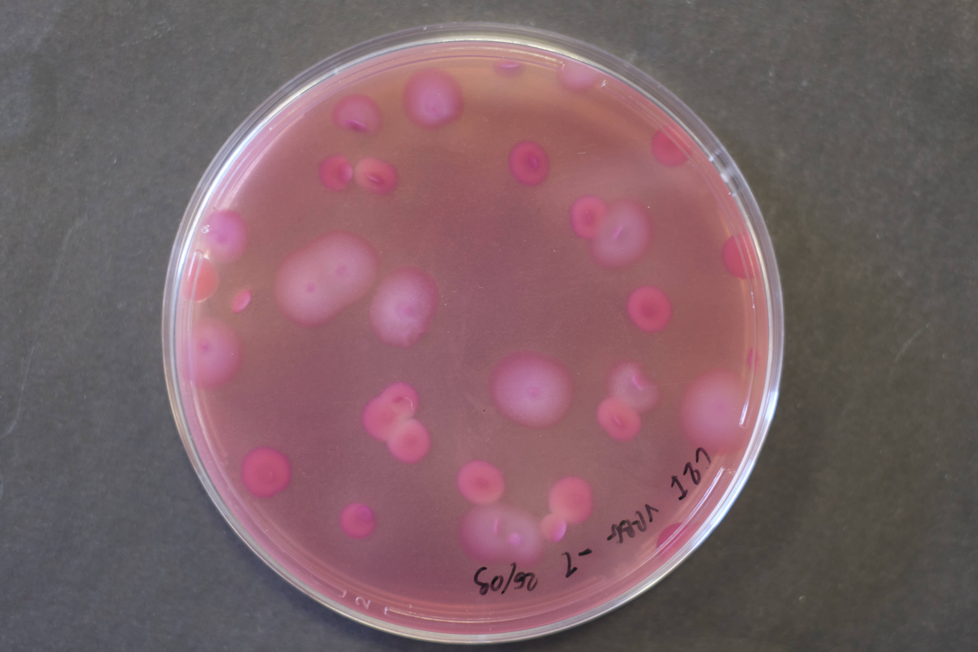
Data Preparation
Deployment:
Once the previous phases have been completed, the ML system can be released for its effective use
Normally, once the model is released, it no longer goes through training and testing phases
Problems:
What happens if the data changes?
If you change the application context?
Example: you have trained a system to count the number of cells in Petri plates. During the development, the background was always yellow, but then something changed…
Possible solution: we can adopt different ways to implement the train-val-test paradigm introduced

Slide 29
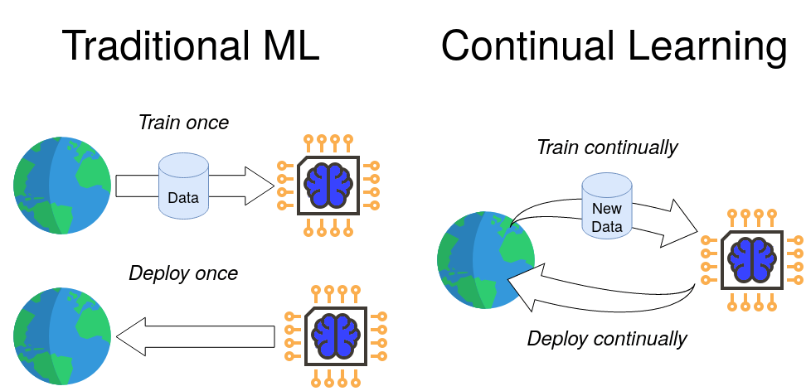
Different ways for train-val-test
We can identify alternatives approaches (adopted by choice or imposed by the context):
Batch Learning:
The training is carried out only once on a given training set
Once the training is finished, the system is deployed and is unable to learn further
Training on the full set of data requires a lot of computing resources
Incremental/Continual/Online Learning:
Following the initial training, further training sessions are possible on data on the fly
Each learning step is faster and cheaper than Batch Learning
Risk: Catastrophic Forgetting (the system forgets what it learned previously)
Natural Learning:
Life-long learning process, this is the closest case to the human learning process
Learning also during the working mode across the (very) long model life
Very challenging.
→ In this course, we will work in the batch mode.

Slide 30
2L Dataset in our exercitations
Euclid dataset
Public datasets

Slide 31
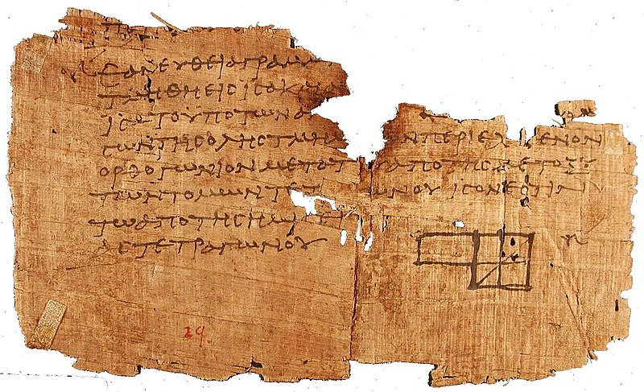
Euclid dataset
In our exercitations, we focus on a dataset referred as «Euclid Dataset»
It is an educational dataset, we can apply algorithms belonging to different areas of AI:
Pattern Recognition
Machine Learning
Deep Learning
The reality is more complex, but with this datasets you will experiment techniques and algorithms that you can apply to more challenging problems
It is a synthetic (artificially created) dataset, therefore we can generate a variable amount of annotated data without a huge investment of time and money.
One of the oldest surviving fragments of Euclid's Elements

Slide 32












Euclid dataset
It is a dataset created for the classification task
The objects to be classified are geometric shapes
You can download Euclid dataset from Virtuale
Rectangles
Triangles
Squares
Rhombi

Slide 33

Euclid dataset: data organization
Images of each class
(.png format)
Annotations
(image_name coordinates)

Slide 34
Euclid dataset: annotations
0_triangle.png 114 221 152 189 223 30
30_square.png 12 15 219 15 219 222 12 222
78_rectangle.png 73 174 176 174 176 220 73 220
x y
Image names
P3
P1
P2
P1
P2
P2
P2
P1
P3
P4
P3
P1
P4
P3
P4

